Slide 1
Movie Recommendation Project
Submitted By:-
Shubham Mittal (RA1811027010018)
Narsimha Reddy (RA1811027010037)
Naman Vats (RA1811027010060)

Slide 2
About our project
The main goal of this data science project is to build a recommendation engine that recommends movies to users.
This R project is designed to help you understand the functioning of how a recommendation system works.
We will be developing an Item Based Collaborative Filter.
Item collaborative filtering(IBCF) is one kind of recommendation method which looks for similar items based on the items users have already liked or positively interacted with.

Slide 3
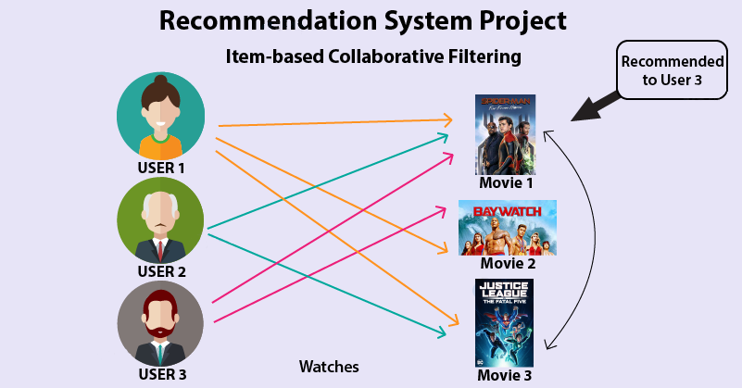

Slide 4
Discovery
Netflix began using analytic tools in 2000 to recommend videos for users to rent.
Netflix’s personalized recommendation algorithms may produce $1 billion a year in value from customer retention.
Majority of Netflix users will consider recommendations and estimated 80% of Netflix views would come from the service’s recommendations.
It will have 1300 recommendation clusters based on users viewing preferences.

Slide 5
Data Preparation
Whenever a user accesses Netflix services, the recommendations system estimates the probability of a user watching a particular title based on the following factors
Viewer interactions with Netflix services like viewer ratings, viewing history, etc.
Information about the categories, year of release, title, genres, and more, other viewers with similar watching preferences and tastes, time duration of a viewer watching a show, the device on which a viewer is watching.

Slide 6
Model Planning
With online streaming, the data that Netflix manages and have access to is limitless. Managing this amount of data is only possible with the right architecture that is segregating offline, online and nearline computation.
With offline computation, there are less limitations on the amount of data and the computational complexity of the algorithms since it runs in a batch manner with relaxed timing requirements.
However, it can easily grow stale between updates because the most recent data is nor incorporated. For personalized architectures, a key issue is combining both online and offline computation in a seamless manner.

Slide 7
With online computation, we expect response to recent events and user interaction and hence has to be done so in real-time.
Therefore, online computation cannot be too complex and computationally costly. Also, a fallback mechanism is necessary such as reverting to a precomputed result.
With nearline computation, we have an intermediate compromise between the two approaches, in that it can perform online-like computations, but do not require them to be served in real-time, allowing it (computing and serving) to be asynchronous.
This opens the door for more complex processing to be done per event, such as updating recommendations to reflect that a movie has been watched immediately after a member begins to watch it.
This is useful for incremental learning algorithms.

Slide 8
Model Building
Recommendation system is a platform that provides its users with various contents based on their preferences and likings.
A recommendation system takes the information about the user as an input. The recommendation system is an implementation of the machine learning algorithms.
There are two types of recommendation systems Content-Based Recommendation System and Collaborative Filtering Recommendation.
In this project of recommendation system in R, we work on a collaborative filtering recommendation system and more specifically, ITEM based collaborative recommendation system.

Slide 9
Operation
It is quite clear that Netflix utilizes a two-tiered row-based ranking system, where ranking happens: Within each row (strongest recommendations on the left) and Across rows (strongest recommendations on top).
Personalized Video Ranking (PVR) , Top-N Video Ranker, Trending Now Ranker, Trending Now Ranker etc. algorithms are used.
Row-based approach: The row-based approach uses existing recommendation or learning-to rank approaches to score each row and rank them based on those scores. This approach can be relatively fast but lacks diversity.

Slide 10
A member might end up seeing a page full of rows that generally matches his/her interest, but row-wise might be very similar.
There are two approaches to integrate diversity, which are mentioned below-
Stage-wise approach: An improvement to the row-rise approach is to use a stage-wise approach, where each row is scored like the above method. However, rows are selected sequentially from the first, and whenever a row is selected, the next rows are recomputed to take into account its relationship to both the previous rows as well as the previous items already chosen for the page.

Slide 11
This is a simple greedy stage-wise approach. We could improve this by using a k-row lookahead approach, where we consider the next k rows when computing the scoring for each row. However, neither of these approaches would obtain a global optimum.
Machine Learning Approach: The solution and approach that Netflix uses is a Machine Learning one, where they aim to create a scoring function by training a model using historical information of which homepages they have created for their members including what they actually see, how they interacted with and what they played.

Slide 12
About the Dataset
In order to build our recommendation system, we have used the MovieLens Dataset. You can find the movies.csv and ratings.csv file that we have used in our Recommendation System Project at the link link https://drive.google.com/file/d/1Dn1BZD3YxgBQJSIjbfNnmCFlDW2jdQGD/view. This data consists of 105339 ratings applied over 10329 movies.

Slide 13
CODE
#MovieLens Recommendation
#MovieLens Data
#library import
library(recommenderlab) #for recommendation
library(ggplot2)
library(data.table)
library(reshape2)
setwd("C:/Users/hp/Downloads/IMDB-Dataset (1)")
movie_data <- read.csv("movies.csv",stringsAsFactors=FALSE)
rating_data <- read.csv("ratings.csv")
str(movie_data)
summary(movie_data)
head(movie_data)
summary(rating_data)
head(rating_data)

Slide 14
movie_genre <- as.data.frame(movie_data$genres, stringsAsFactors=FALSE)
library(data.table)
movie_genre2 <- as.data.frame(tstrsplit(movie_genre[,1], '[|]', type.convert=TRUE),
stringsAsFactors=FALSE) #DataFlair
colnames(movie_genre2) <- c(1:10)
list_genre <- c("Action", "Adventure", "Animation", "Children",
"Comedy", "Crime","Documentary", "Drama", "Fantasy",
"Film-Noir", "Horror", "Musical", "Mystery","Romance",
"Sci-Fi", "Thriller", "War", "Western")
genre_mat1 <- matrix(0,10330,18)
genre_mat1[1,] <- list_genre
colnames(genre_mat1) <- list_genre
for (index in 1:nrow(movie_genre2)) {
for (col in 1:ncol(movie_genre2)) {
gen_col = which(genre_mat1[1,] == movie_genre2[index,col]) #Author DataFlair
genre_mat1[index+1,gen_col] <- 1 }}

Slide 15
genre_mat2 <- as.data.frame(genre_mat1[-1,], stringsAsFactors=FALSE) #remove first row, which was the genre list
for (col in 1:ncol(genre_mat2)) {
genre_mat2[,col] <- as.integer(genre_mat2[,col]) #convert from characters to integers}
str(genre_mat2)
SearchMatrix <- cbind(movie_data[,1:2], genre_mat2[])
head(SearchMatrix)
ratingMatrix <- dcast(rating_data, userId~movieId, value.var = "rating", na.rm=FALSE)
ratingMatrix <- as.matrix(ratingMatrix[,-1]) #remove userIds
#Convert rating matrix into a recommenderlab sparse matrix
ratingMatrix <- as(ratingMatrix, "realRatingMatrix")
ratingMatrix
recommendation_model <- recommenderRegistry$get_entries(dataType = "realRatingMatrix")
names(recommendation_model)
lapply(recommendation_model, "[[", "description")
recommendation_model$IBCF_realRatingMatrix$parameters
similarity_mat= similarity(ratingMatrix[1:4, ],method = "cosine",which="users")
as.matrix(similarity_mat)

Slide 16
image(as.matrix(similarity_mat), main = "User's Similarity")
movie_similarity <- similarity(ratingMatrix[, 1:4], method ="cosine", which = "items")
as.matrix(movie_similarity)
image(as.matrix(movie_similarity), main = "Movies similarity")
rating_values <- as.vector(ratingMatrix@data)
unique(rating_values) # extracting unique ratings
Table_of_Ratings <- table(rating_values) # creating a count of movie ratings
library(ggplot2)movie_views <- colCounts(ratingMatrix) # count views for each movie
table_views <- data.frame(movie = names(movie_views),
views = movie_views) # create dataframe of views
table_views <- table_views[order(table_views$views,
decreasing = TRUE), ] # sort by number of viewstable_views$title <- NA
for (index in 1:10325){ table_views[index,3] <- as.character(subset(movie_data,movie_data$movieId == table_views[index,1])$title)}table_views[1:6,]

Slide 17
ggplot(table_views[1:6, ], aes(x = title, y = views)) +
geom_bar(stat="identity", fill = 'steelblue') +
geom_text(aes(label=views), vjust=-0.3, size=3.5) +
theme(axis.text.x = element_text(angle = 45, hjust = 1)) +
ggtitle("Total Views of the Top Films")
image(ratingMatrix[1:20, 1:25], axes = FALSE, main = "Heatmap of the first 25 rows and 25 columns")
movie_ratings <- ratingMatrix[rowCounts(ratingMatrix) > 50,
colCounts(ratingMatrix) > 50]
minimum_movies<- quantile(rowCounts(movie_ratings), 0.98)
minimum_users <- quantile(colCounts(movie_ratings), 0.98)
image(movie_ratings[rowCounts(movie_ratings) > minimum_movies,
colCounts(movie_ratings) > minimum_users],
main = "Heatmap of the top users and movies")
average_ratings <- rowMeans(movie_ratings)
qplot(average_ratings, fill=I("steelblue"), col=I("red")) +
ggtitle("Distribution of the average rating per user")
normalized_ratings <- normalize(movie_ratings)
sum(rowMeans(normalized_ratings) > 0.00001)

Slide 18
image(normalized_ratings[rowCounts(normalized_ratings) > minimum_movies,
colCounts(normalized_ratings) > minimum_users],
main = "Normalized Ratings of the Top Users")
binary_minimum_movies <- quantile(rowCounts(movie_ratings), 0.95)
binary_minimum_users <- quantile(colCounts(movie_ratings), 0.95)
#movies_watched <- binarize(movie_ratings, minRating = 1)
good_rated_films <- binarize(movie_ratings, minRating = 3)
image(good_rated_films[rowCounts(movie_ratings) > binary_minimum_movies,
colCounts(movie_ratings) > binary_minimum_users],
main = "Heatmap of the top users and movies")
sampled_data<- sample(x = c(TRUE, FALSE),
size = nrow(movie_ratings),
replace = TRUE,
prob = c(0.8, 0.2))
training_data <- movie_ratings[sampled_data, ]
testing_data <- movie_ratings[!sampled_data, ]
recommendation_system <- recommenderRegistry$get_entries(dataType ="realRatingMatrix")
recommendation_system$IBCF_realRatingMatrix$parameters

Slide 19
recommen_model <- Recommender(data = training_data,method = "IBCF", parameter = list(k = 30))
recommen_model
class(recommen_model)
model_info <- getModel(recommen_model)
class(model_info$sim)
dim(model_info$sim)
top_items <- 20
image(model_info$sim[1:top_items, 1:top_items],main = "Heatmap of the first rows and columns")
um_rows <- rowSums(model_info$sim > 0)
table(sum_rows)
sum_cols <- colSums(model_info$sim > 0)
qplot(sum_cols, fill=I("steelblue"), col=I("red"))+ ggtitle("Distribution of the column count")
top_recommendations <- 10 # the number of items to recommend to each user
predicted_recommendations <- predict(object = recommen_model,newdata = testing_data,n = top_recommendations)
predicted_recommendations
user1 <- predicted_recommendations@items[[1]] # recommendation for the first user

Slide 20
movies_user1 <- predicted_recommendations@itemLabels[user1]
movies_user2 <- movies_user1
for (index in 1:10){
movies_user2[index] <- as.character(subset(movie_data,movie_data$movieId == movies_user1[index])$title)}
movies_user2
recommendation_matrix <- sapply(predicted_recommendations@items,
function(x){ as.integer(colnames(movie_ratings)[x]) }) # matrix with the recommendations for each user
#dim(recc_matrix)
recommendation_matrix[,1:4]
number_of_items <- factor(table(recommendation_matrix))
chart_title <- "Distribution of the Number of Items for IBCF"
qplot(number_of_items, fill=I("steelblue"), col=I("red")) + ggtitle(chart_title)
number_of_items_sorted <- sort(number_of_items, decreasing = TRUE)
number_of_items_top <- head(number_of_items_sorted, n = 4)
table_top <- data.frame(as.integer(names(number_of_items_top)),number_of_items_top)
for(i in 1:4) {
table_top[i,1] <- as.character(subset(movie_data,
movie_data$movieId == table_top[i,1])$title)}

Slide 21
colnames(table_top) <- c("Movie Title", "No. of Items")
head(table_top)
#THE DESIRED OUTPUT

Slide 22
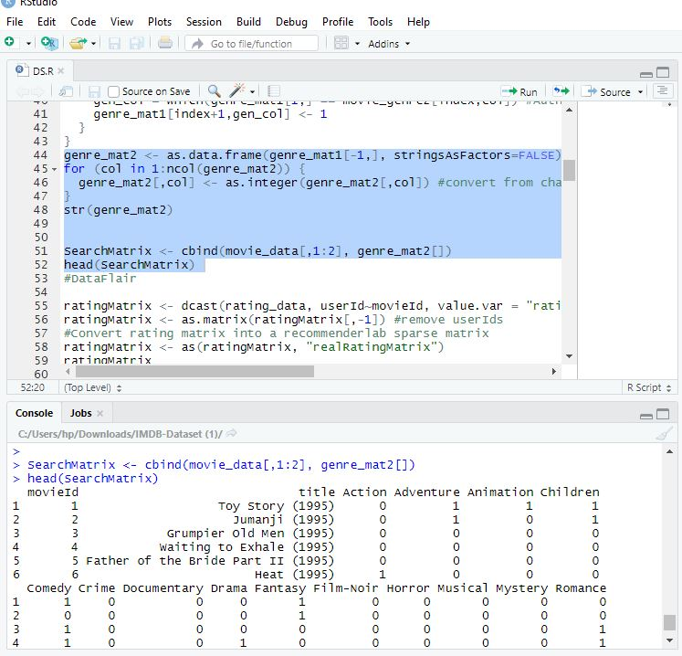

Slide 23
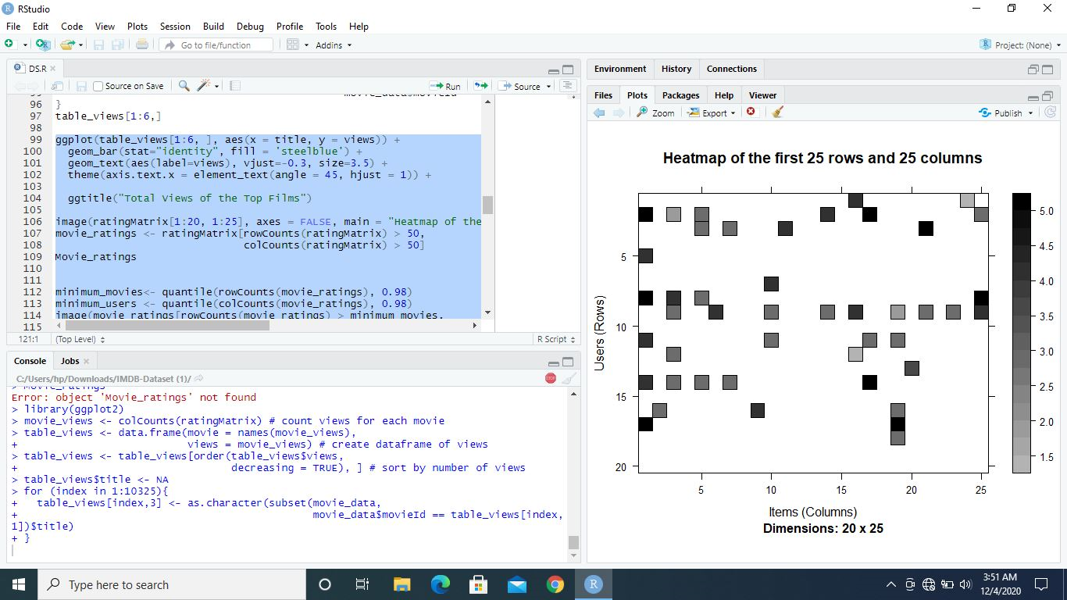

Slide 24
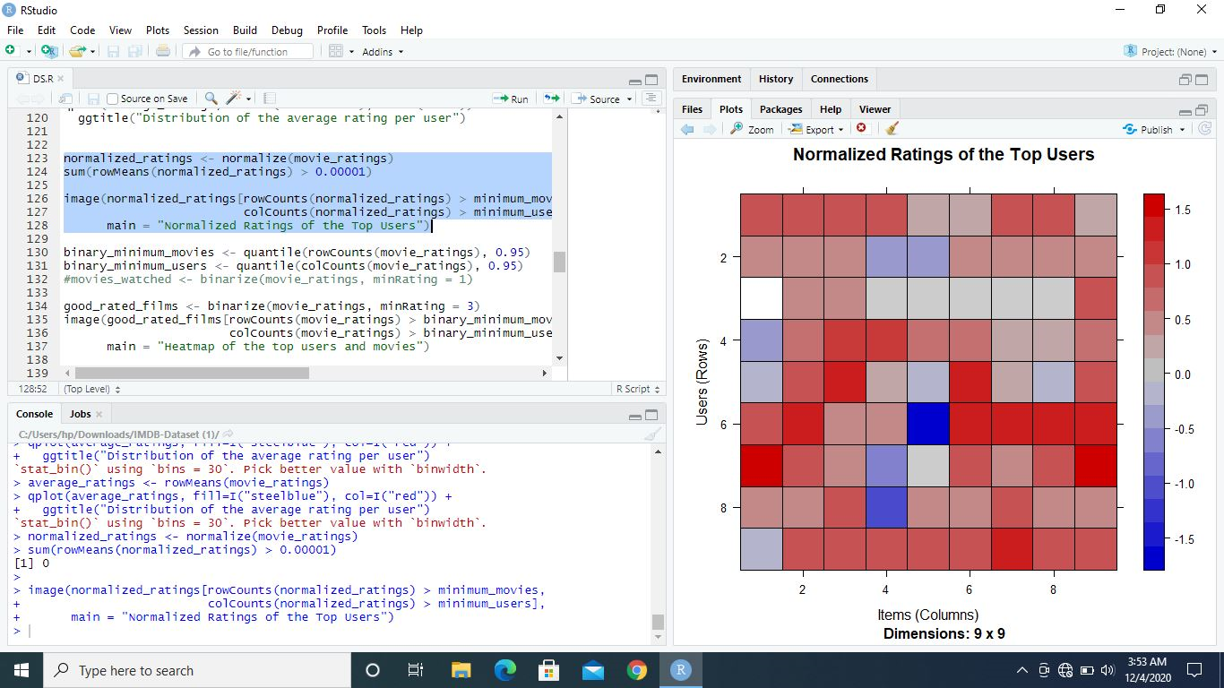

Slide 25
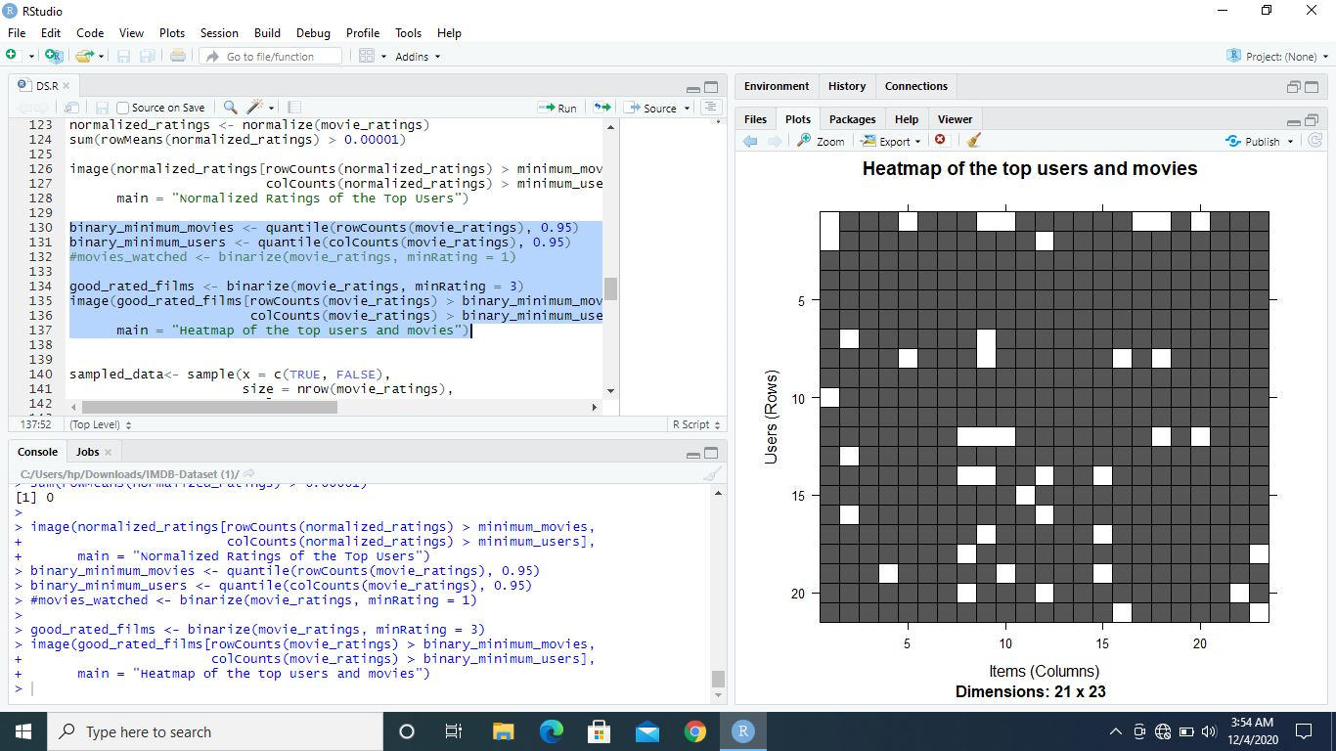

Slide 26
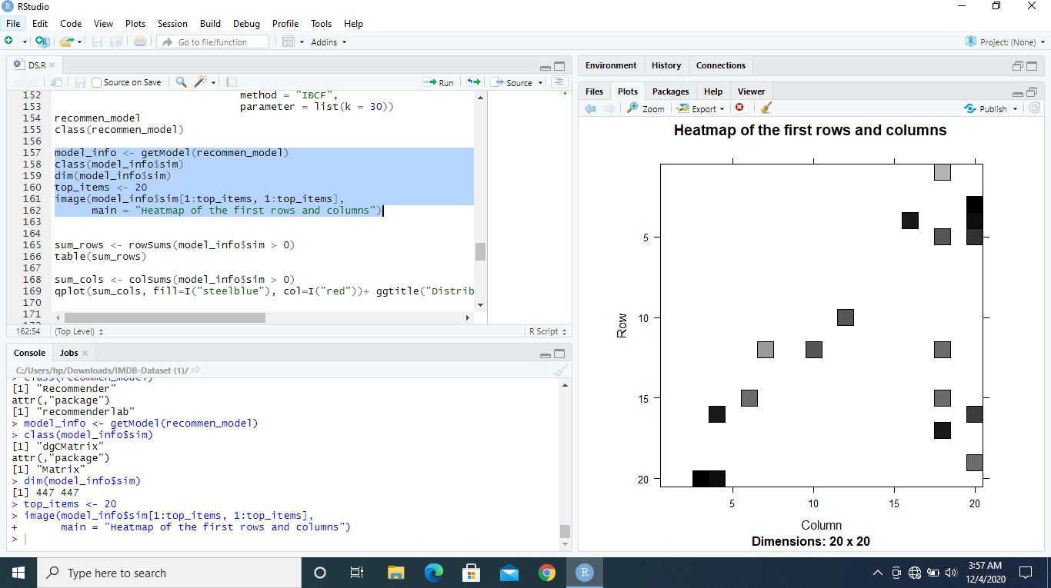

Slide 27
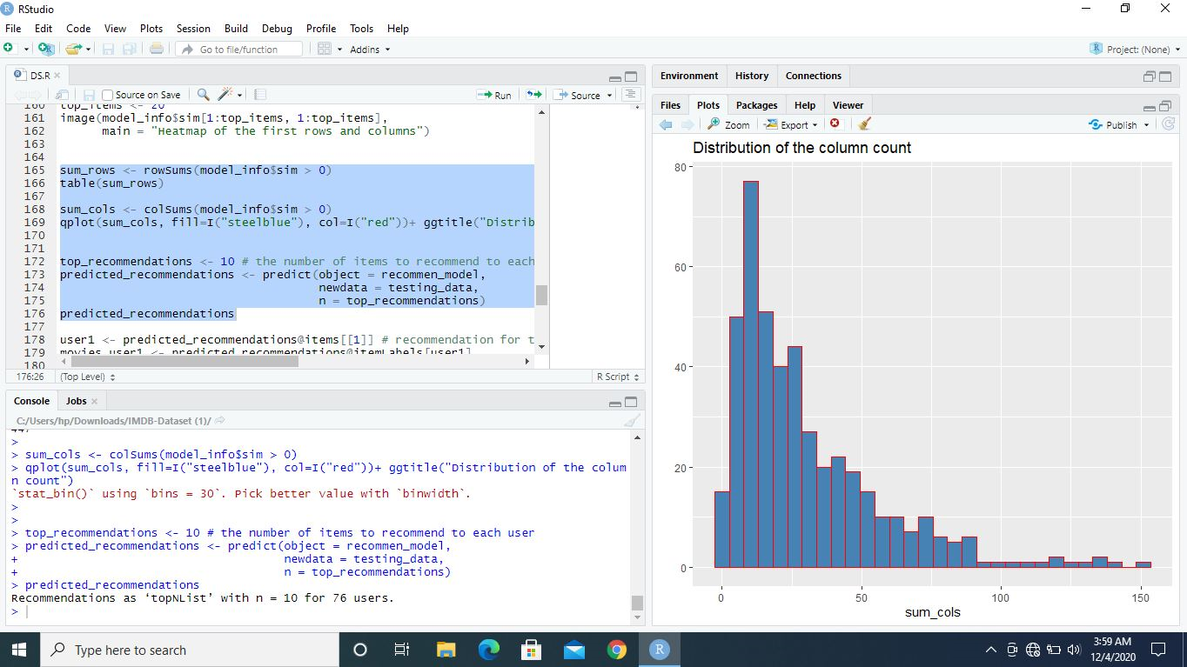

Slide 28
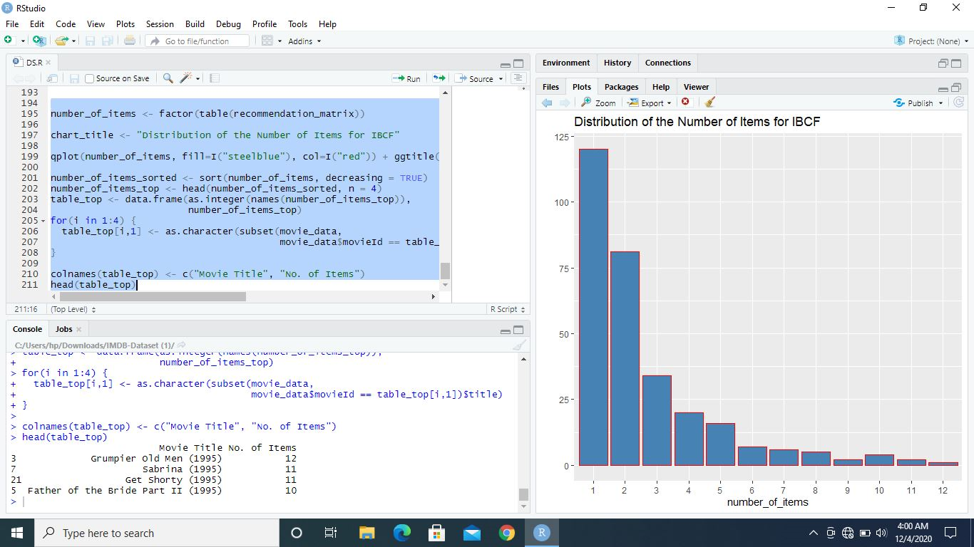

Slide 29
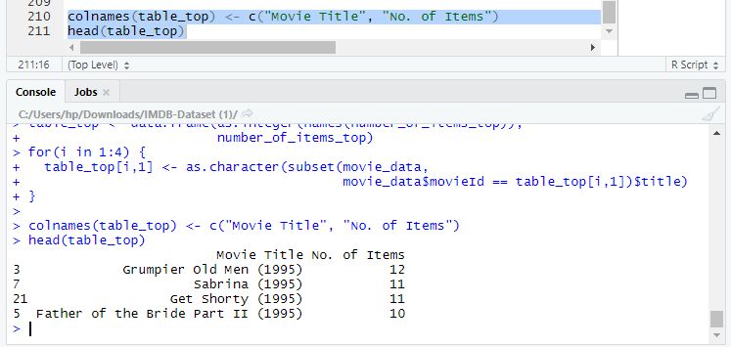
FINAL OUTPUT

Slide 30
Communicate Results
Netflix just has a 90-second window to help viewers find a movie or a TV show before they leave the platform and visit some other service.
That’s one of the major reasons why Netflix is so obsessed with personalizing recommendations to hook users.
Netflix’s personalized recommendation algorithms produce $1 billion a year in value from customer retention.

Slide 31
Majority of Netflix users consider recommendations with 80% of Netflix views coming from the service’s recommendations. Netflix has set up 1300 recommendation clusters based on users viewing preferences.
Netflix segments its viewers into over 2K taste groups. Based on the taste group a viewer falls, it dictates the recommendations.
With over 7000 TV shows and movies in the catalogue, it is actually impossible for a viewer to find movies they like to watch on their own.
Netflix’s recommendation engine automates this search process for its users.

